Slide 1

Digital Health Card
Chandrakant Palandurkar (PRN: 250845920015)
Kedar Mane (PRN: 250845920032)
Poonam Agrawal (PRN: 250845920050)
Puja Ulhas Wagh (PRN: 250845920063)
Waghmode Vaibhavi (PRN: 250245920095

Slide 2

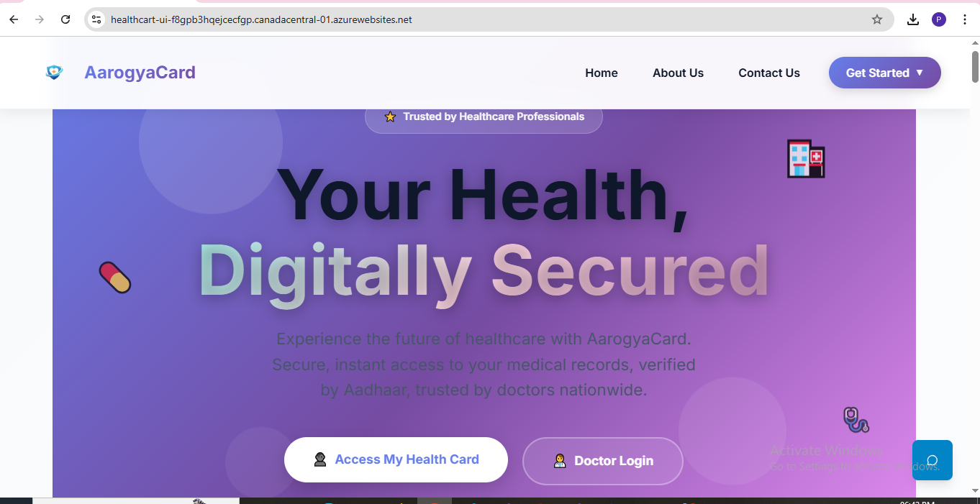
Aarogya Card

Slide 3
Abstract
The Digital Health Card System is a secure healthcare management platform that allows patients to access and manage their medical records digitally. The system eliminates the need for carrying physical medical reports by providing centralized, role-based access to patient health data. It involves four main entities: Admin, Patient, Doctor, Lab Technician. Aadhaar-based authentication, admin verification, and patient consent ensure data security, privacy, and controlled access to sensitive medical information.

Slide 4
Introduction
In today’s fast-paced healthcare environment, managing medical records in physical form has become inefficient and unreliable. Patients often misplace reports or forget to carry them during consultations, leading to delays in diagnosis and treatment. Moreover, sharing medical data among healthcare providers remains a challenge due to the lack of a centralized and secure platform.
The Digital Health Card System addresses these challenges by providing a secure digital solution for storing and accessing patient medical records. The system uses Aadhaar-based authentication to uniquely identify patients and generates a Health Card ID that acts as a digital identity for accessing medical data. With role-based access control, the system ensures that only authorized users such as doctors and lab technicians can upload or modify patient data after admin verification. This system aims to improve healthcare efficiency, data accessibility, and patient safety.

Slide 5
Problem Statement
In the existing healthcare system, patients are required to carry physical medical reports during hospital visits or emergencies. These reports can be misplaced, damaged, or unavailable when urgently needed. There is no centralized, secure, and easily accessible digital platform that allows patients, doctors, and laboratories to manage medical records efficiently. Additionally, unauthorized access to sensitive health data and lack of patient consent mechanisms create privacy and security concerns. Hence, there is a need for a secure digital system that enables electronic storage, controlled access, and easy retrieval of medical records using reliable authentication methods.

Slide 6
Project Overview
The Digital Health Card System is designed to provide patients with secure digital access to their medical records, eliminating the need to carry physical reports. The system ensures centralized storage, controlled access, and role-based permissions for healthcare stakeholders.
The system consists of four main entities:
Admin, Patient, Doctor and Lab Technician.

Slide 7
Aim
The aim of the Digital Health Card System is to provide a secure, centralized, and digital platform for managing patient medical records, enabling easy access to health information for patients, doctors, and lab technicians while eliminating the need for carrying physical medical reports

Slide 8
Objective
To develop a Digital Health Card System that allows patients to access medical records digitally.
To eliminate the need for carrying physical medical reports.
To implement Aadhaar-based authentication and OTP verification for secure patient registration and login.
To generate a unique Health Card ID (HC + Aadhaar Number) for each patient.
To provide role-based access for Admin, Patient, Doctor, Lab Technician.
To ensure admin verification of doctors and lab technicians before system access.
To allow doctors and lab technicians to upload and manage medical reports digitally.
To provide patient consent-based access to doctors for viewing medical records.

Slide 9
Scope of the Project
The scope of the Digital Health Card System includes:
Secure storage and management of patient health records.
Aadhaar-based patient identity verification.
Digital access to prescriptions, lab reports, and medical history.
Admin-controlled verification of healthcare professionals.
Consent-based and emergency access mechanisms.
The system is designed for hospitals, clinics, diagnostic labs, and patients.
The project focuses on digital record management and does not replace medical diagnosis or treatment processes.

Slide 10
Limitations
Requires Aadhaar card and linked mobile number for authentication.
Needs continuous internet connection to work properly.
Uses hardcoded admin credentials, which limits scalability.
No offline access to medical records.
Users with low technical knowledge may find it difficult to use

Slide 11
Module

Slide 12
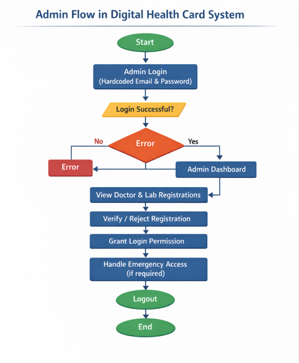
Admin Module
Admin login using hardcoded credentials.
Verification and approval of doctor registrations.
Verification and approval of lab technician registrations.
Management of emergency access permissions.

Slide 13
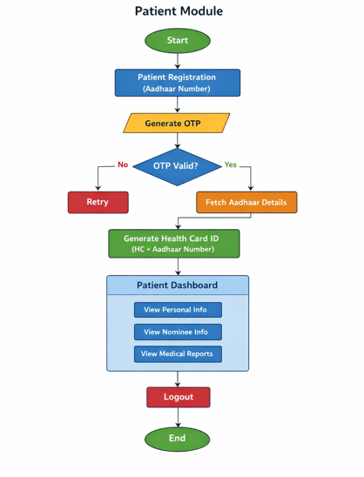
Patient Module
Registration using Aadhaar card.
OTP-based login authentication.
Automatic fetching of patient details using Aadhaar data.
Generation of Health Card ID (HC + Aadhaar Number).
Viewing personal details and nominee information.
Viewing uploaded medical reports.
Approval or rejection of doctor access requests.

Slide 14
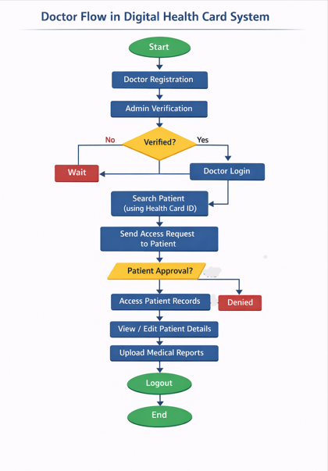
Doctor Module
Doctor registration and profile submission.
Login after admin verification.
Search patient using Health Card ID.
Request patient consent to access medical records.
View and edit patient medical information.
Upload prescriptions and medical reports.

Slide 15
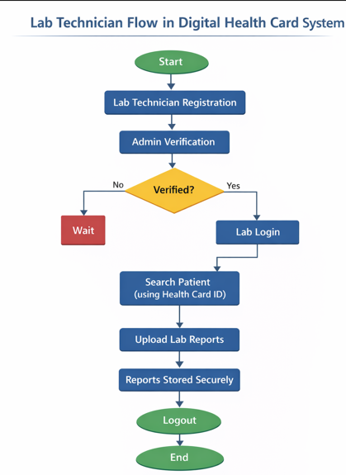
Lab Technician Module
Lab technician registration.
Login after admin verification.
Search patient using Health Card ID.
Upload diagnostic and laboratory reports.

Slide 16
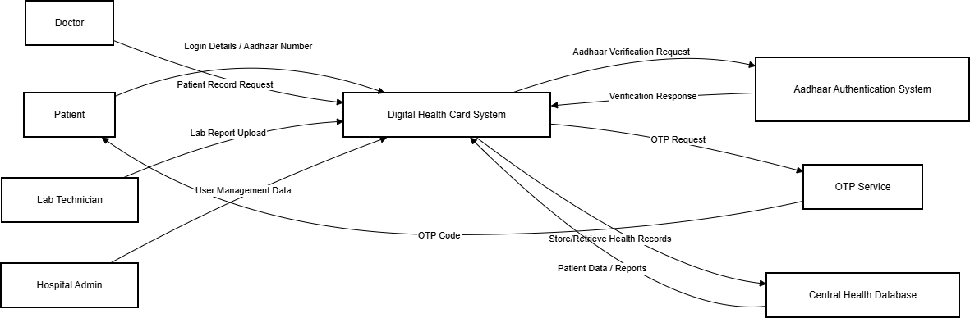
Data Flow Diagram

Slide 17
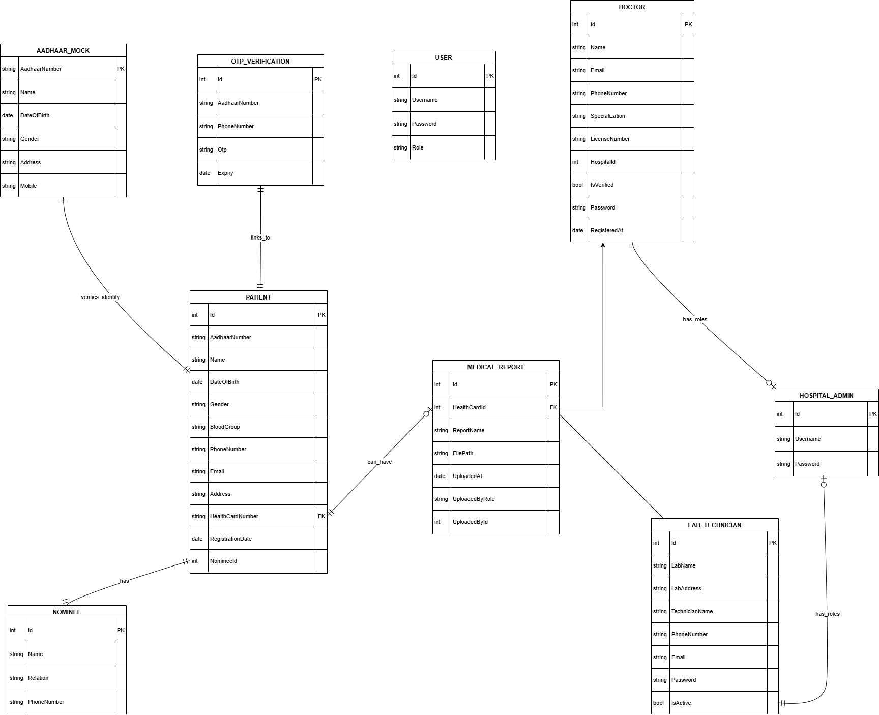
Entity Relation Diagram

Slide 18
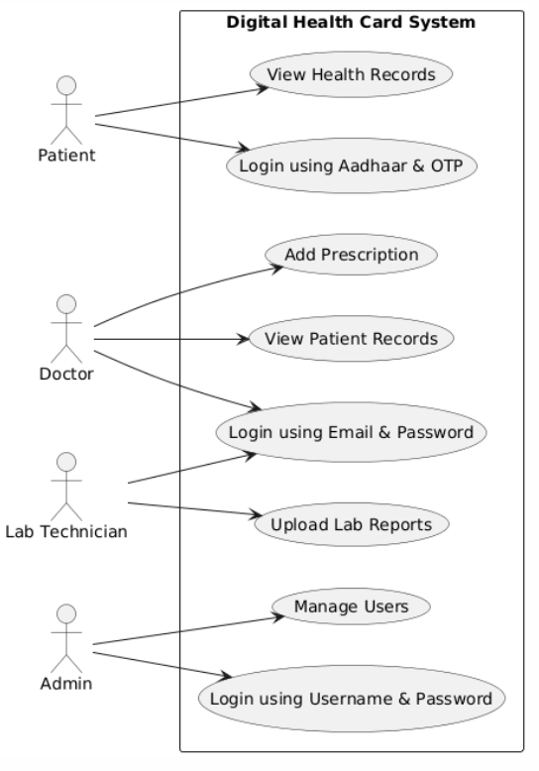
Use Case Diagram

Slide 19
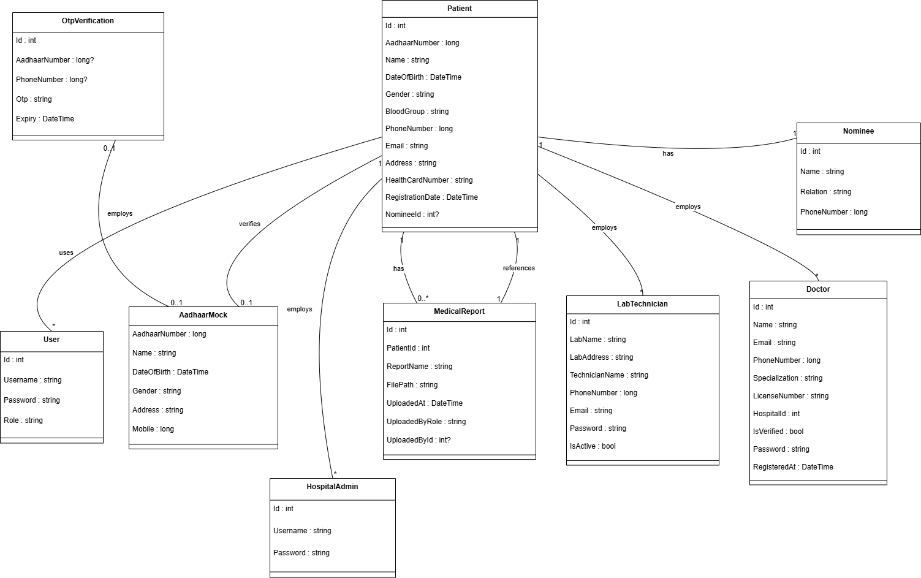
Class Diagram

Slide 20
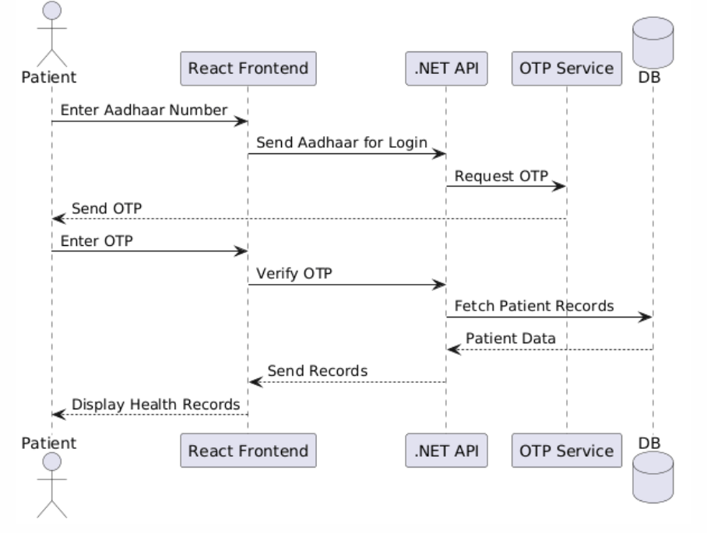
Sequence Diagram

Slide 21
Software Requirements Specification
Hardware Requirements
Processor: Intel i3 or above
RAM: Minimum 4 GB
Storage: 100GB HDD or SSD
Software Requirements
Operating System: Any Operating System(Windows ,Linux,MacOs)
Frontend: HTML, CSS(TalwindCSS), Javascript, React.js
Backend: ASP.NET Core 8.0 Web App
Database: MYSQL
Browser :Google Chrome / Mozilla FireFox / Microsoft Edge
Server: http
IDE: Visual Studio, VS Code

Slide 22
Conclusion
The Digital Health Card System successfully provides a secure and efficient platform for managing patient medical records digitally. By eliminating the need for physical reports and introducing Aadhaar-based authentication, the system ensures easy access and improved reliability of medical data. Role-based access control and admin verification enhance system security, while digital report uploads by doctors and lab technicians ensure accurate and up-to-date medical information. The emergency feature further strengthens the system by enabling timely treatment during critical situations. Overall, the system contributes to a more organized, accessible, and patient-centric healthcare management approach and has the potential for future expansion with advanced technologies and real-world integrations.

Slide 23
Future Scope
Integration with real Aadhaar APIs for live verification
Mobile application version of the system
Biometric authentication for enhanced security
AI-based health analysis and report predictions
Integration with hospitals and pharmacies
Blockchain-based storage for tamper-proof medical records
Appointment scheduling and notification system
Multi-language support for wider accessibility

Slide 24
Thank You

